Slide 1
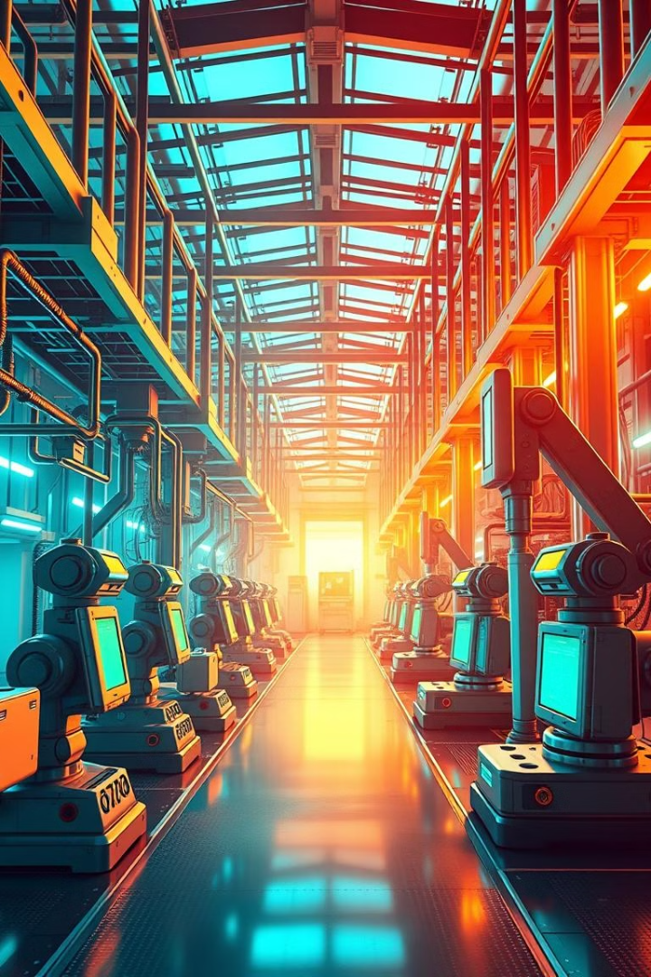

Artificial Intelligence in Manufacturing
This presentation explores the transformative potential of Artificial Intelligence (AI) in the manufacturing industry, highlighting its key applications and benefits.
by ShaTech jsjk

Slide 2
The Transformative Role of AI in the Manufacturing Industry
Increased Efficiency
Enhanced Productivity
Improved Decision-Making
AI streamlines processes, optimizes resource allocation, and reduces waste.
AI-powered systems can work 24/7, boosting production and output.
AI provides data-driven insights for better strategic planning and execution.

Slide 3
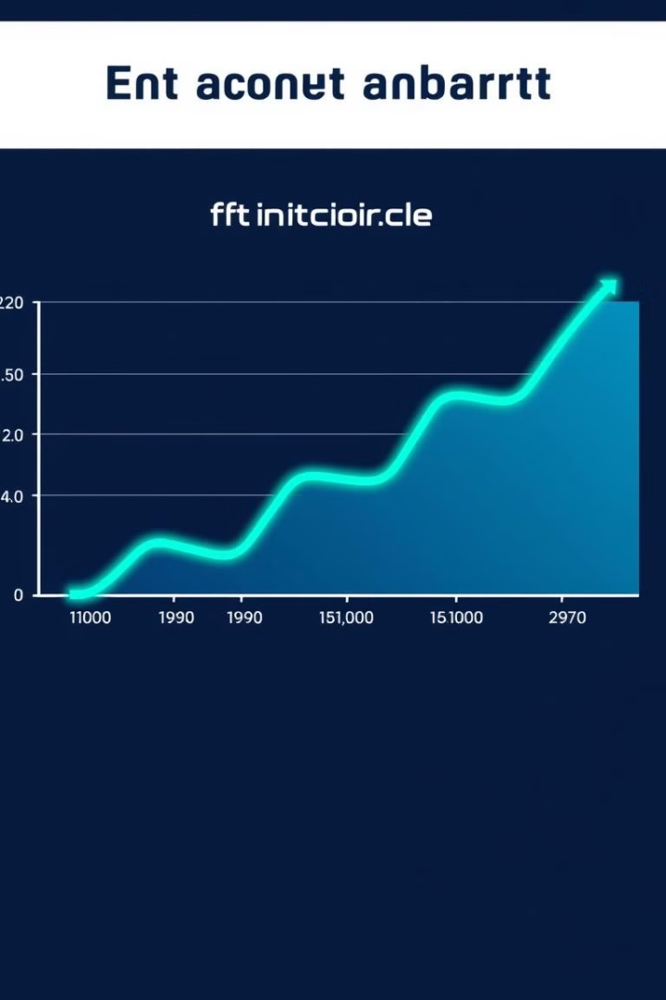
Enhancing Operational Efficiency Through AI-Driven Optimization
1
Real-Time Monitoring
2
Predictive Maintenance
AI monitors production lines, detecting anomalies and predicting issues.
AI analyzes equipment data to anticipate breakdowns and schedule maintenance.
3
Inventory Management
AI optimizes inventory levels, reducing waste and storage costs.

Slide 4




Improving Safety and Mitigating Risks with AI Technologies
Hazard Detection
Automated Safety Measures
AI identifies potential risks and alerts workers to avoid accidents.
AI-powered robots can perform hazardous tasks, protecting human workers.
Emergency Response
AI can rapidly assess situations and guide emergency procedures.

Slide 5

Accelerating Product Development and Design Innovation
1
Design Optimization
AI analyzes data to improve product design, functionality, and aesthetics.
2
Material Selection
AI recommends optimal materials based on performance, cost, and sustainability.
3
Prototyping and Testing
AI speeds up prototyping and testing, allowing for rapid iteration.

Slide 6




Upskilling the Workforce with AI-Driven Training and Simulations
AI-Based Training Programs
AI provides personalized training modules tailored to individual needs.
Interactive Simulations
AI creates immersive simulations for hands-on learning and skill development.
Skill Gap Analysis
AI identifies skill gaps and recommends appropriate training programs.

Slide 7



Optimizing Supply Chain Management Through AI Integration
Demand Forecasting
1
AI analyzes historical data to predict future demand and optimize production.
Inventory Management
2
AI optimizes inventory levels and ensures timely delivery.
Route Optimization
3
AI identifies the most efficient routes for transportation and logistics.

Slide 8
AI-Powered Predictive Maintenance: Reducing Downtime and Costs
Sensor Data Analysis
1
AI analyzes sensor data to detect anomalies and predict equipment failure.
Maintenance Scheduling
2
AI optimizes maintenance schedules based on predicted failure rates.
Preventive Maintenance
3
AI proactively identifies and addresses issues before they lead to downtime.

Slide 9

Leveraging AI to Streamline Manufacturing Processes and Boost Productivity
10%
5%
Increased Efficiency
Enhanced Quality
AI can reduce process time and minimize waste.
AI ensures consistent quality and reduces defects.
20%
Boost in Productivity
AI optimizes processes and resource allocation.

Slide 10
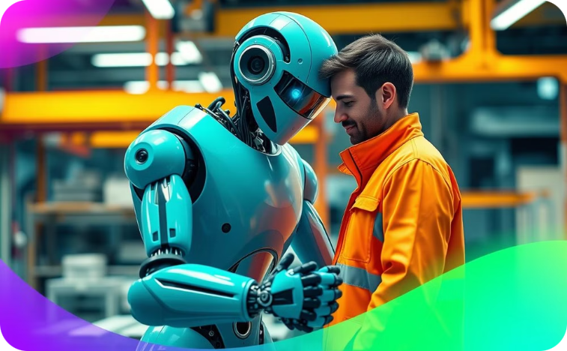
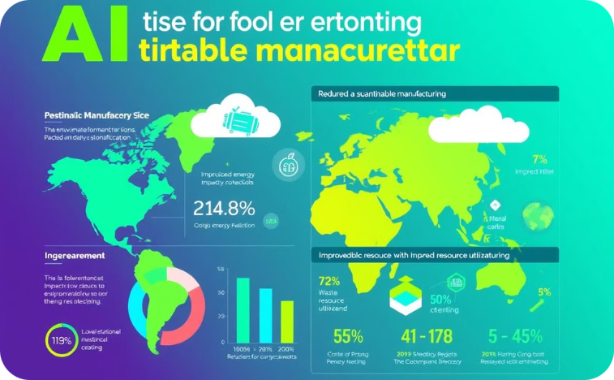
The Future of Manufacturing: Responsible AI Adoption and Policymaking
Human-Robot Collaboration
Sustainable Manufacturing
AI will empower humans to focus on higher-value tasks while robots perform repetitive or dangerous tasks.
AI can help companies reduce their environmental footprint and improve sustainability through resource optimization and waste reduction.

